Slide 1
Air Fly Insights: Data Visualization and Analysis of Airline Operations
Power BI Dashboard Project Presentation
Maheshvari A S
maheshvari722004@gmail.com

Slide 2
Project Overview
This project focuses on analysing airline operations data using interactive data visualization techniques. A Power BI dashboard was developed to identify patterns in:
• Flight volume • Delay trends • Cancellation behaviour • Airport-level performance • Airline-wise efficiency
The goal is to convert raw aviation data into actionable visual insights.

Slide 3
Dataset Description
Source: Kaggle Airline Flights Dataset Data Period Used: January 2019 – June 2019
Fields Used in Dashboard:
• Airline • Origin Airport • Destination Airport • Departure Time • Arrival Delay • Cancellation Status • Delay Reasons

Slide 4
Data Cleaning & Preparation
The following preprocessing steps were performed:
• Removed duplicate flight records • Handled missing values in delay and cancellation columns • Corrected data types for date and time fields • Split and formatted date–time columns • Created new calculated columns such as: – Month – Day of Week – Departure Hour – Flight Route (Origin → Destination)
This ensured the dataset was accurate, structured, and ready for visual analysis.

Slide 5
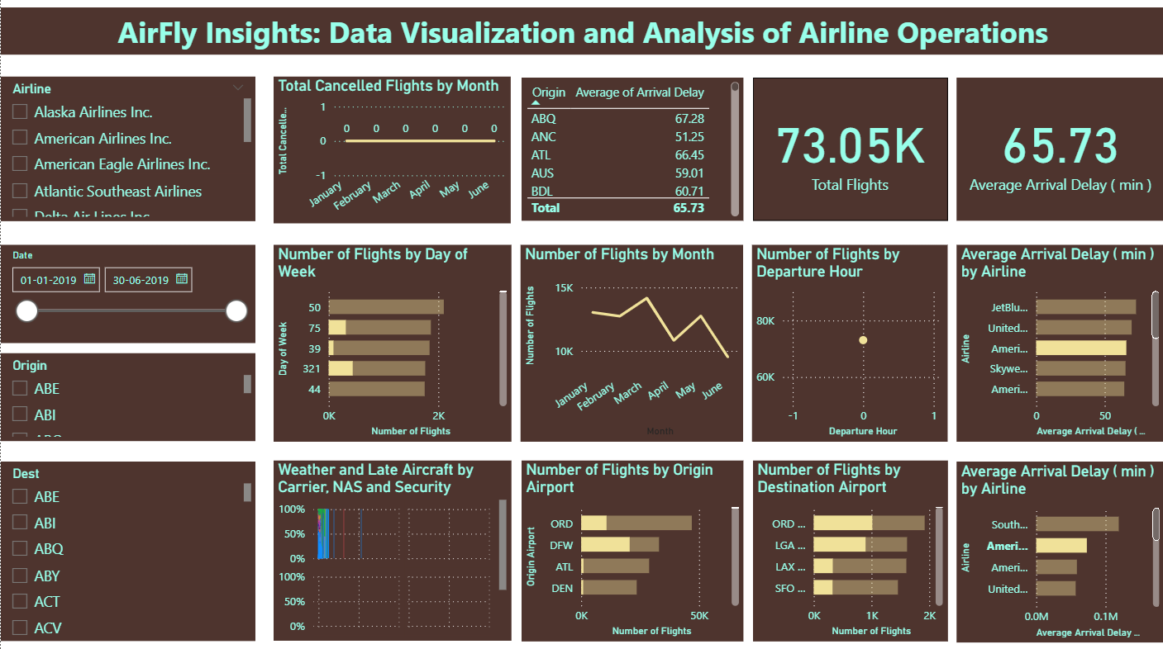
DASHBOARD STRUCTURE

Slide 6
DASHBOARD STRUCTURE
Top Section:
• Airline slicer for filtering by airline • Date range filter (01-01-2019 to 30-06-2019) • KPI Cards showing: – Total Flights (484.55K) – Average Arrival Delay (60.91 minutes)

Slide 7
DASHBOARD STRUCTURE
Middle Section:
• Flights by Day of Week bar chart • Flights by Month line chart • Flights by Departure Hour scatter plot • Average Delay by Airline bar chart

Slide 8
DASHBOARD STRUCTURE
Bottom Section:
• Weather & Delay Reason stacked chart • Flights by Origin Airport • Flights by Destination Airport • Average Delay by Airline comparison chart

Slide 9
Key Performance Indicators
From the dashboard KPI cards:
• Total Flights Analyzed: 484,550 flights • Average Arrival Delay: 60.91 minutes
These indicators summarize the operational performance and delay intensity.

Slide 10
Flight Volume Analysis
Insights from the dashboard charts:
• March and April show the highest flight volume • January and February had comparatively fewer flights • Weekdays show consistent traffic, with some variation across days

Slide 11
Delay Analysis Results
Based on visualizations:
• Evening departure hours show higher flight density and delays • Certain airlines show higher average arrival delays • Major hub airports showed greater delay values due to congestion
Delay causes analyzed: • Weather delays • Carrier delays • NAS (National Airspace System) delays • Security-related delays

Slide 12
Cancellation Pattern Analysis
From the chart “Total Cancelled Flights by Month”:
• Cancellations were lower during mid-months • Weather and carrier issues were the dominant causes • Cancellation trends were seasonal and varied month-wise
This supports airline operational improvement planning.

Slide 13
Airport-Level Performance
From dashboard charts:
Top origin airports by flight count: • ORD • DFW • ATL • DEN
Top destination airports: • ORD • LGA • LAX • SFO
These airports show heavy traffic and higher operational pressure.

Slide 14
Route Analysis
Using origin and destination analysis:
• High-frequency routes were identified • Congested routes showed higher delay patterns • Dashboards enabled filtering to analyze specific airport pairs
This helps understand traffic flow efficiency.

Slide 15
Modules Implemented
Data Acquisition and Understanding ✅
Data Cleaning and Feature Engineering ✅
Univariate and Bivariate Analysis ✅
Delay Cause Analysis ✅
Cancellation and Seasonal Trends ✅
Airport and Route-Level Exploration ✅
Power BI Dashboard Development ✅
Technical Documentation ✅

Slide 16
Week-wise Execution
Week 1–2: Data loading, cleaning, feature creation Week 3–4: Visualization and delay analysis Week 5–6: Cancellation & route analysis Week 7: Dashboard development Week 8: Final reporting and presentation

Slide 17
Future Enhancements
Machine learning model for delay prediction
Real-time dashboard with API integration
Advanced airport congestion visualization

Slide 18
Conclusion
This project successfully transformed large-scale airline data into meaningful visual insights using Power BI.
The dashboard helps identify operational inefficiencies and supports data-driven decision-making.

Slide 19
Thank You
Thank you for the opportunity to present this project.

